Slide 1


PYTHON
Lecture 48

Slide 2

Today’s Agenda
Exception Handling
Introduction To Exception Handling
Exception Handling Keywords
Exception Handling Syntax
Handling Multiple Exceptions
Handling All Exceptions

Slide 3
What Is An Exception ?
Exception are errors that occur at runtime .
In other words , if our program encounters an abnormal situation during it’s execution it raises an exception.
For example,the statement
a=10/0
will generate an exception because Python has no way to
solve division by 0

Slide 4
What Python Does When An Exception Occurs ?
Whenever an exception occurs , Python does 2 things :
It immediately terminates the code
It displays the error message related to the exception in a technical way
Both the steps taken by Python cannot be considered user friendly because
Even if a statement generates exception , still other parts of the program must get a chance to run
The error message must be simpler for the user to understand

Slide 5
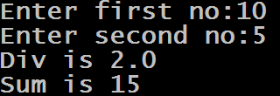
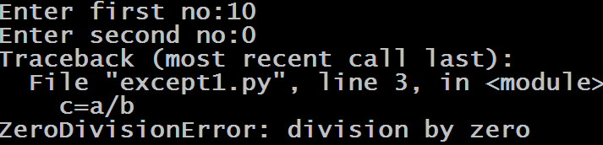
A Sample Code
a=int(input("Enter first no:"))
b=int(input("Enter second no:"))
c=a/b
print("Div is",c)
d=a+b
print("Sum is",d)
Output:
As we can observe , in the second run the code generated exception because Python does not know how to handle division by 0. Moreover it did not even calculated the sum of 10 and 0 which is possible

Slide 6
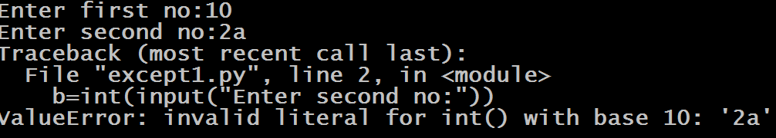
A Sample Code
a=int(input("Enter first no:"))
b=int(input("Enter second no:"))
c=a/b
print("Div is",c)
d=a+b
print("Sum is",d)
Output:
In this case since it is not possible for Python to covert “2a” into an integer , so it generated an exception . But the message it displays is too technical to understand

Slide 7
How To Handle Such Situations ?
If we want our program to behave normally , even if an exception occurs , then we will have to apply Exception Handling
Exception handling is a mechanism which allows us to handle errors gracefully while the program is running instead of abruptly ending the program execution.

Slide 8
Exception Handling Keywords
Python provides 5 keywords to perform Exception Handling:
try
except
else
raise
finally

Slide 9
Exception Handling Syntax
Following is the syntax of a Python try-except-else block.
try:
You do your operations here;
......................
except ExceptionI:
If there is ExceptionI, then execute this block.
except ExceptionII:
If there is ExceptionII, then execute this block.
......................
else:
If there is no exception then execute this block.
Remember !
In place of Exception I and Exception II , we have to use the names of Exception classes in Python

Slide 10
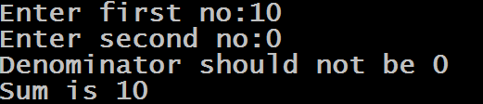
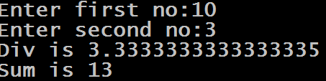
Improved Version Of Previous Code
a=int(input("Enter first no:"))
b=int(input("Enter second no:"))
try:
c=a/b
print("Div is",c)
except ZeroDivisionError:
print("Denominator should not be 0")
d=a+b
print("Sum is",d)
Output:

Slide 11
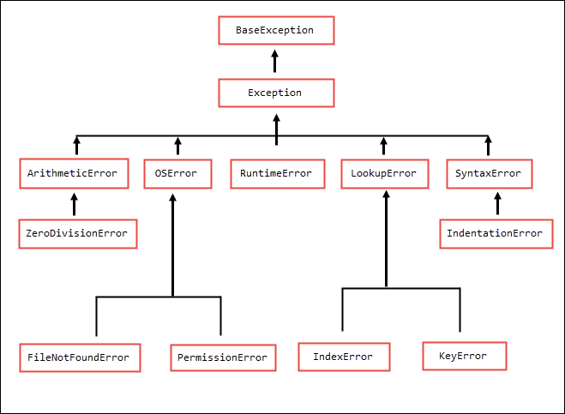
Exception Hierarchy

Slide 12
Important Exception Classes
Exception Class | Description
Exception | Base class for all exceptions
ArithmeticError | Raised when numeric calculations fails
FloatingPointError | Raised when a floating point calculation fails
ZeroDivisionError | Raised when division or modulo by zero takes place for all numeric types
OverflowError | Raised when result of an arithmetic operation is too large to be represented
ImportError | Raised when the imported module is not found in Python version < 3.6
ModuleNotFoundError | Raised when the imported module is not found from Python version >=3.6

Slide 13
Important Exception Classes
Exception Class | Description
LookUpError | Raised when searching /lookup fails
KeyError | Raised when the specified key is not found in the dictionary
IndexError | Raised when index of a sequence is out of range
NameError | Raised when an identifier is not found in the local or global namespace
UnboundLocalError | Raise when we use a local variable in a function before declaring it.
TypeError | Raised when a function or operation is applied to an object of incorrect type
ValueError | Raised when a function gets argument of correct type but improper value

Slide 14
Important Exception Classes
Exception Class | Description
AttributeError | Raised when a non-existent attribute is referenced.
OSError | Raised when system operation causes system related error.
FileNotFoundError | Raised when a file is not present
FileExistsError | Raised when we try to create a directory which is already present
PermissionError | Raised when trying to run an operation without the adequate access rights.
SyntaxError | Raised when there is an error in Python syntax.
IndentationError | Raised when indentation is not specified properly.

Slide 15
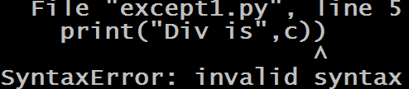
A Very Important Point!
Amongst all the exceptions mentioned in the previous slides, we cannot handle SyntaxError exception , because it is raised by Python even before the program starts execution
Example:
a=int(input("Enter first no:"))
b=int(input("Enter second no:"))
try:
c=a/b
print("Div is",c))
except SyntaxError:
print("Wrong Syntax")
d=a+b
print("Sum is",d)
Output:

Slide 16
Handling Multiple Exception
A try statement may have more than one except clause for different exceptions.
But at most one except clause will be executed

Slide 17
Point To Remember
Also , we must remember that if we are handling parent and child exception classes in except clause then the parent exception must appear after child exception , otherwise child except will never get a chance to run

Slide 18

Guess The Output !
import math
try:
x=10/5
print(x)
ans=math.exp(3)
print(ans)
except ZeroDivisionError:
print("Division by 0 exception occurred!")
except ArithmeticError:
print("Numeric calculation failed!")
Output:

Slide 19
Guess The Output !
import math
try:
x=10/0
print(x)
ans=math.exp(20000)
print(ans)
except ZeroDivisionError:
print("Division by 0 exception occurred!")
except ArithmeticError:
print("Numeric calculation failed!")
Output:

Slide 20

Guess The Output !
import math
try:
x=10/5
print(x)
ans=math.exp(20000)
print(ans)
except ZeroDivisionError:
print("Division by 0 exception occurred!")
except ArithmeticError:
print("Numeric calculation failed!")
Output:

Slide 21
Guess The Output !
import math
try:
x=10/5
print(x)
ans=math.exp(20000)
print(ans)
except ArithmeticError:
print("Numeric calculation failed!")
except ZeroDivisionError:
print("Division by 0 exception occurred!")
Output:

Slide 22
Guess The Output !
import math
try:
x=10/0
print(x)
ans=math.exp(20000)
print(ans)
except ArithmeticError:
print("Numeric calculation failed!")
except ZeroDivisionError:
print("Division by 0 exception occurred!")
Output:

Slide 23
Exercise
Write a program to ask the user to input 2 integers and calculate and print their division. Make sure your program behaves as follows:
If the user enters a non integer value then ask him to enter only integers
If denominator is 0 , then ask him to input non-zero denominator
Repeat the process until correct input is given
Only if the inputs are correct then display their division and terminate the code

Slide 24
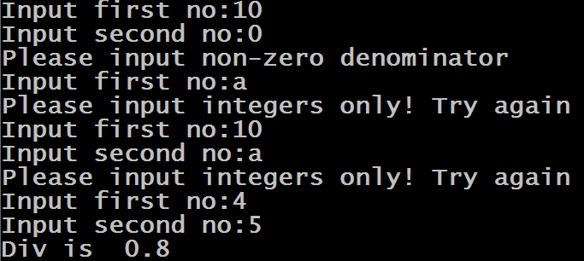
Sample Output

Slide 25
Solution
while(True):
try:
a=int(input("Input first no:"))
b=int(input("Input second no:"))
c=a/b
print("Div is ",c)
break;
except ValueError:
print("Please input integers only! Try again")
except ZeroDivisionError:
print("Please input non-zero denominator")

Slide 26
Single except, Multiple Exception
If we want to write a single except clause to handle multiple exceptions , we can do this .
For this we have to write names of all the exceptions within parenthesis separated with comma after the keyword except

Slide 27
Example
while(True):
try:
a=int(input("Input first no:"))
b=int(input("Input second no:"))
c=a/b
print("Div is ",c)
break;
except (ValueError,ZeroDivisionError):
print("Either input is incorrect or denominator is 0. Try again!")

Slide 28
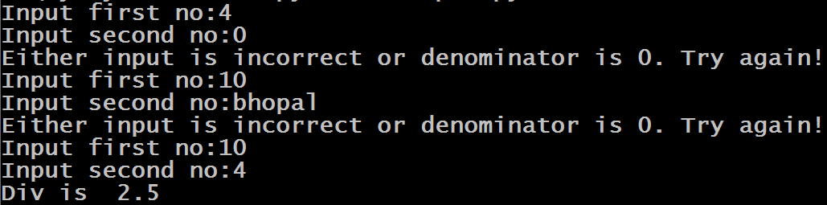
Sample Output

Slide 29
Handling All Exceptions
We can write the keyword except without any exception class name also .
In this case for every exception this except clause will run .
The only problem will be that we will never know the type of exception that has occurred!

Slide 30
Exception Handling Syntax
Following is the syntax of a Python handle all exception block.
try:
You do your operations here;
......................
except :
For every kind of exception this block will execute
Notice , we have not provided any name for the exception

Slide 31
Example
while(True):
try:
a=int(input("Input first no:"))
b=int(input("Input second no:"))
c=a/b
print("Div is ",c)
break;
except:
print("Some problem occurred. Try again!")

Slide 32
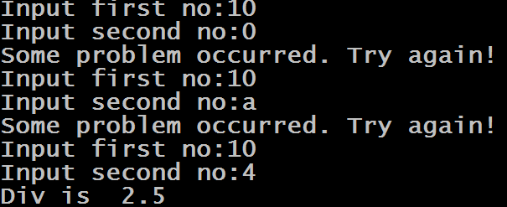
Sample Output

